Slide 1

Get Moving App
By Jade Sainui
Assessment#3
Task PWA

Slide 2
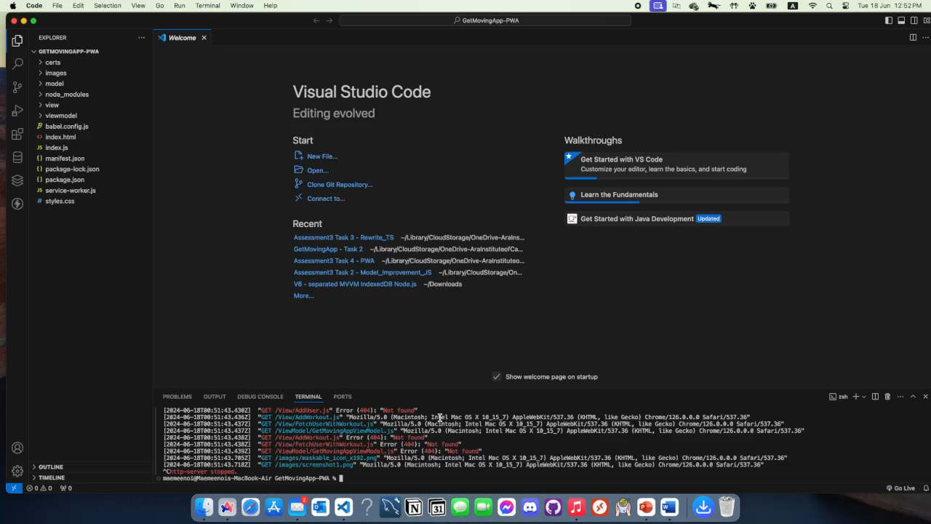
demonstration vid

Slide 3
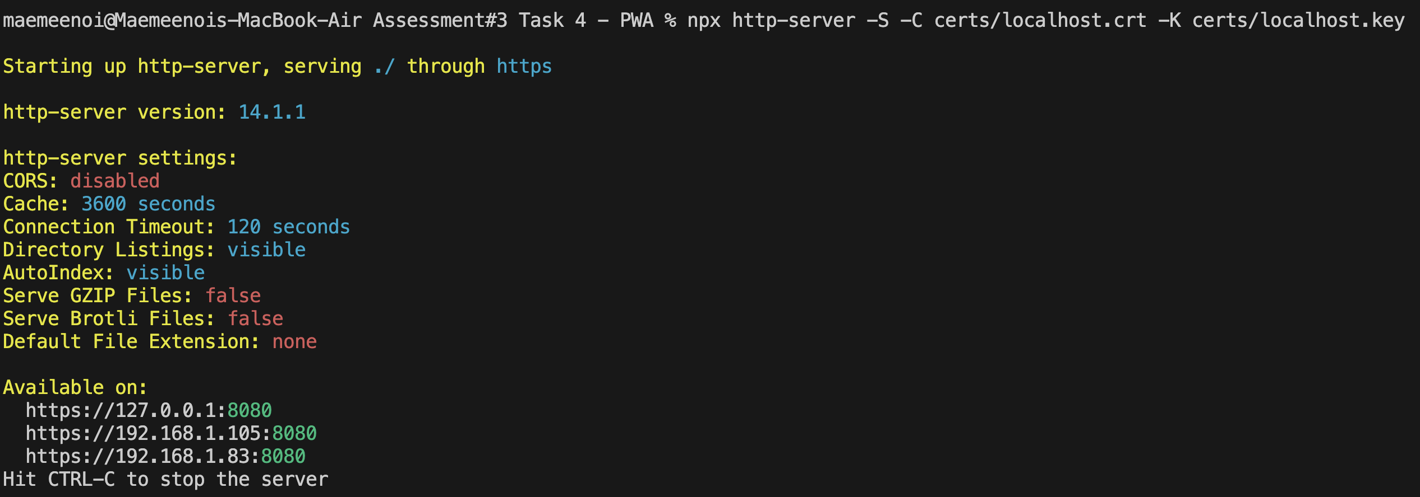
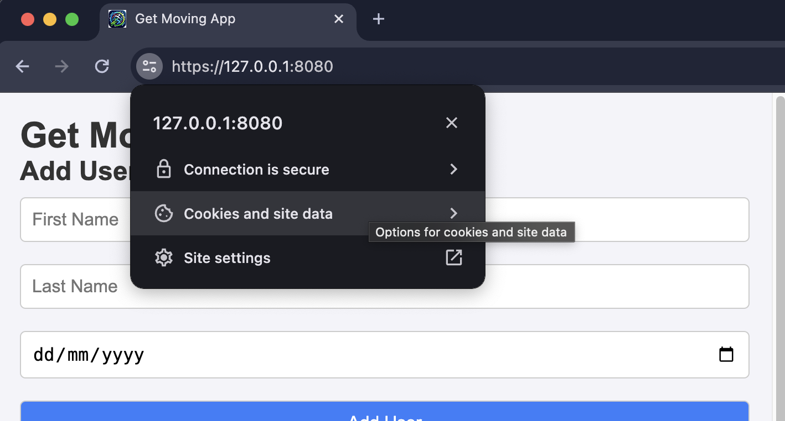
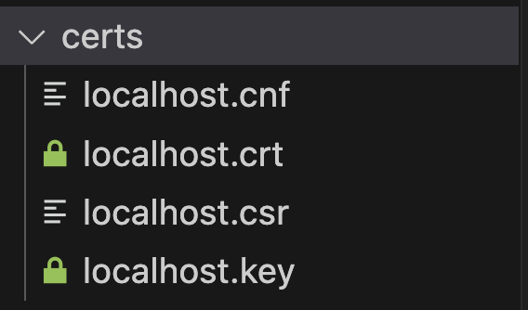
Establishing a Local Web Server with HTTPS for PWA Distribution
Task Objective: Set up a local web server using the HTTPS protocol to distribute Progressive Web App (PWA) to end-users.
Validation: Provide a brief screen recording that clearly demonstrates the setup process and the resulting functionality to validate the successful completion of this task.

Slide 4
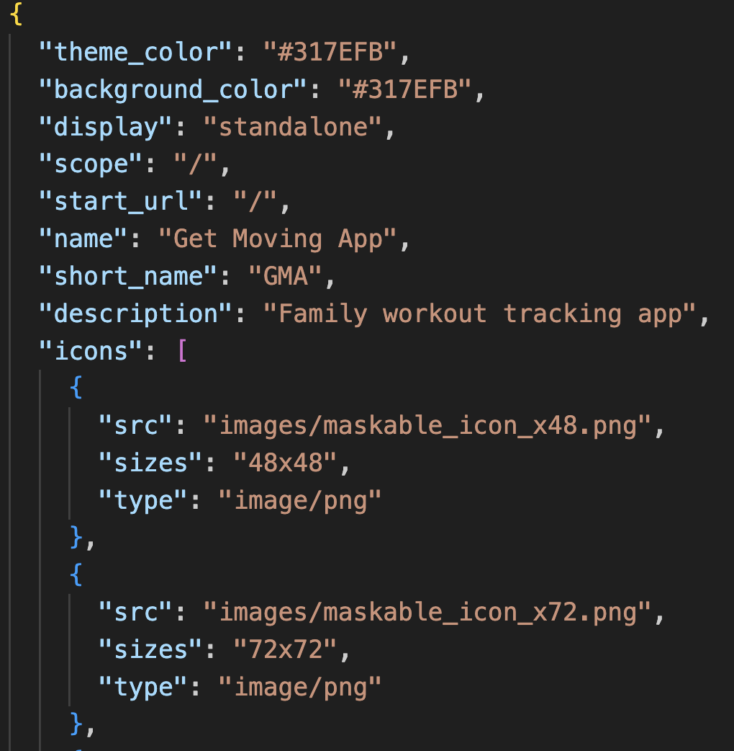
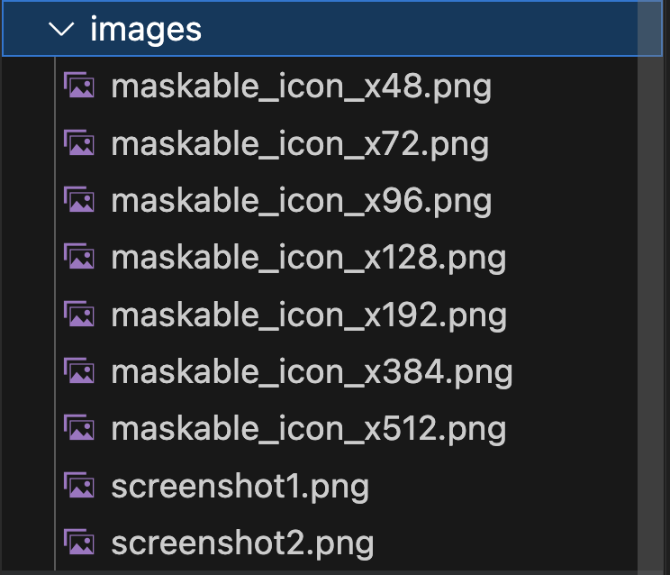
Create a web app manifest and set up its related resources.

Slide 5
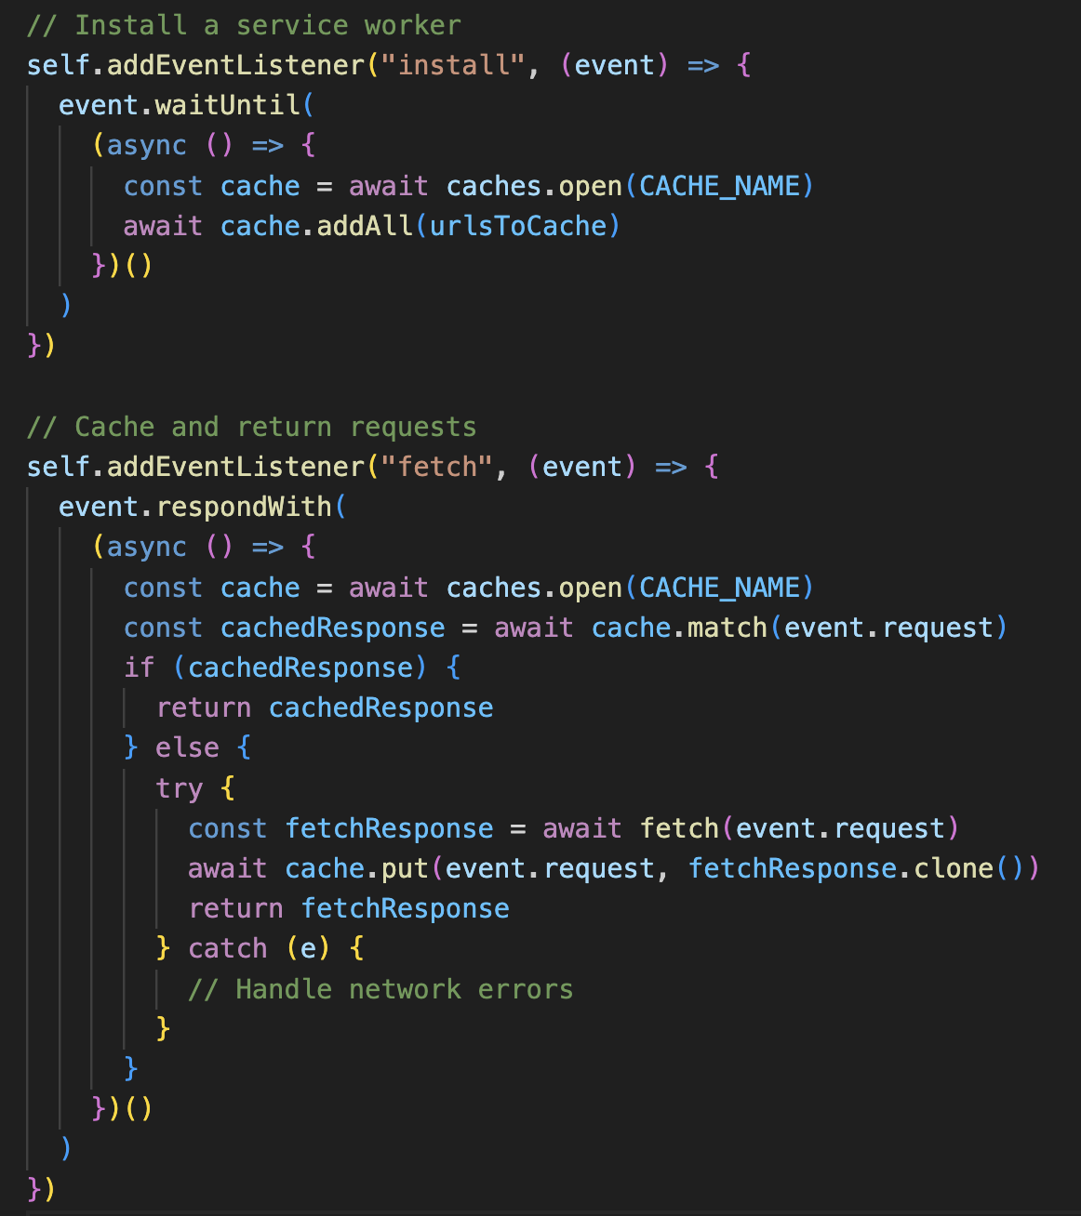
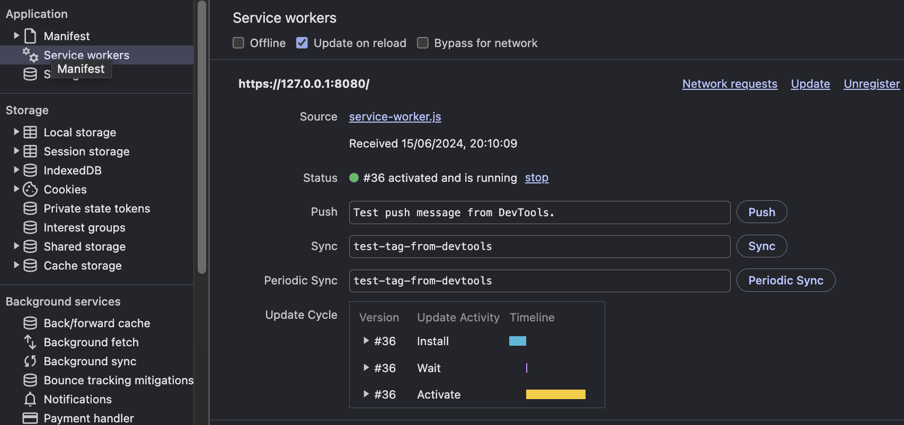
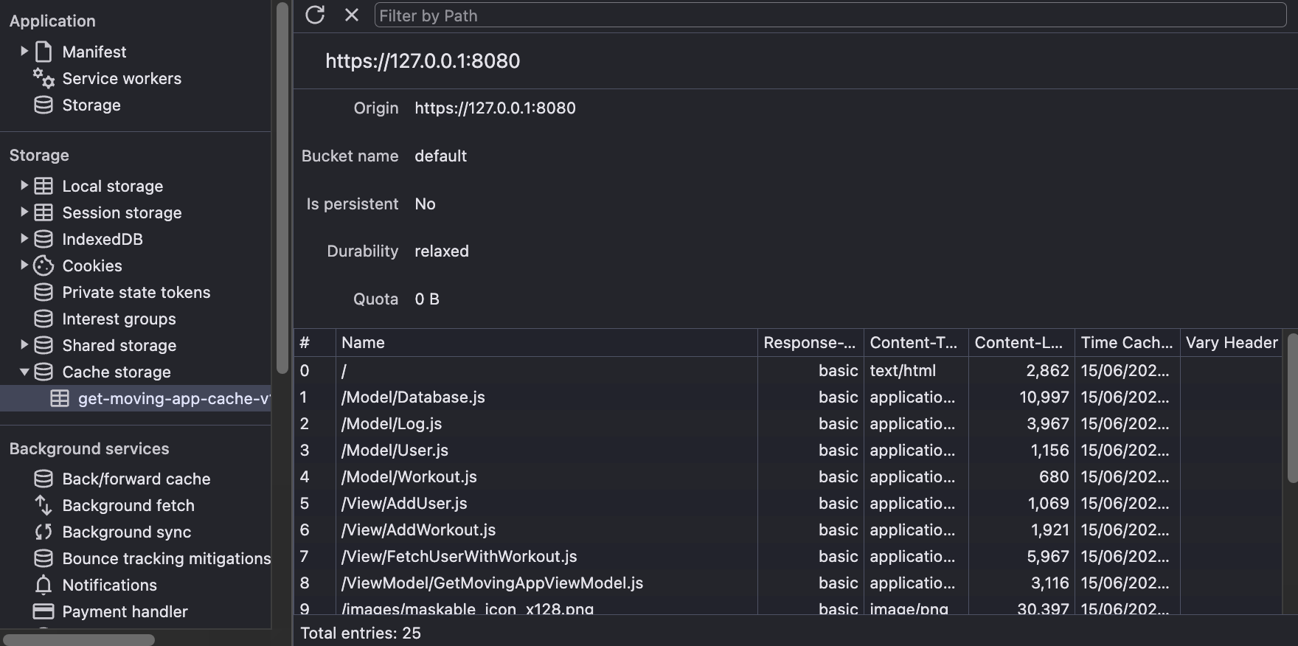
Creating and Registering a Service Worker for Offline Support
Task Objective: Create and register a service worker that can handle install and fetch events to provide offline support via Fetch and Cache APIs.
Validation: Ensure the service worker is correctly handling these events, thereby enabling offline capabilities for your Progressive Web App (PWA).

Slide 6
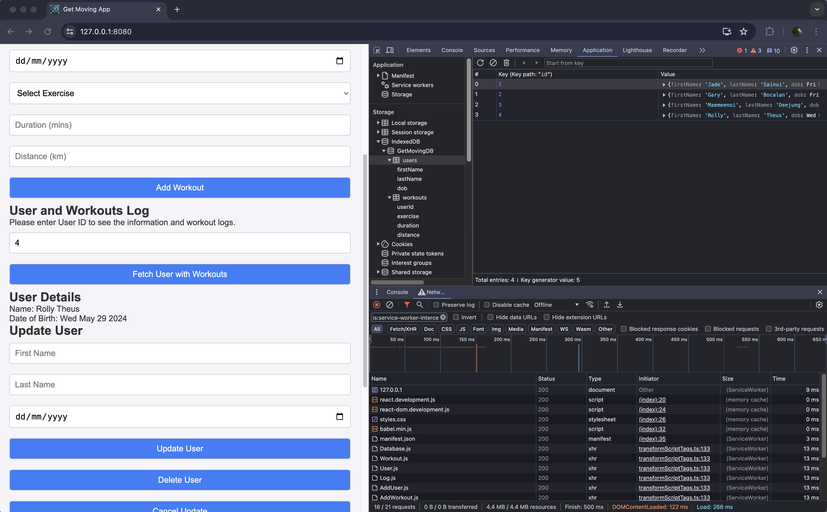
Work When offline as its cache

Slide 7

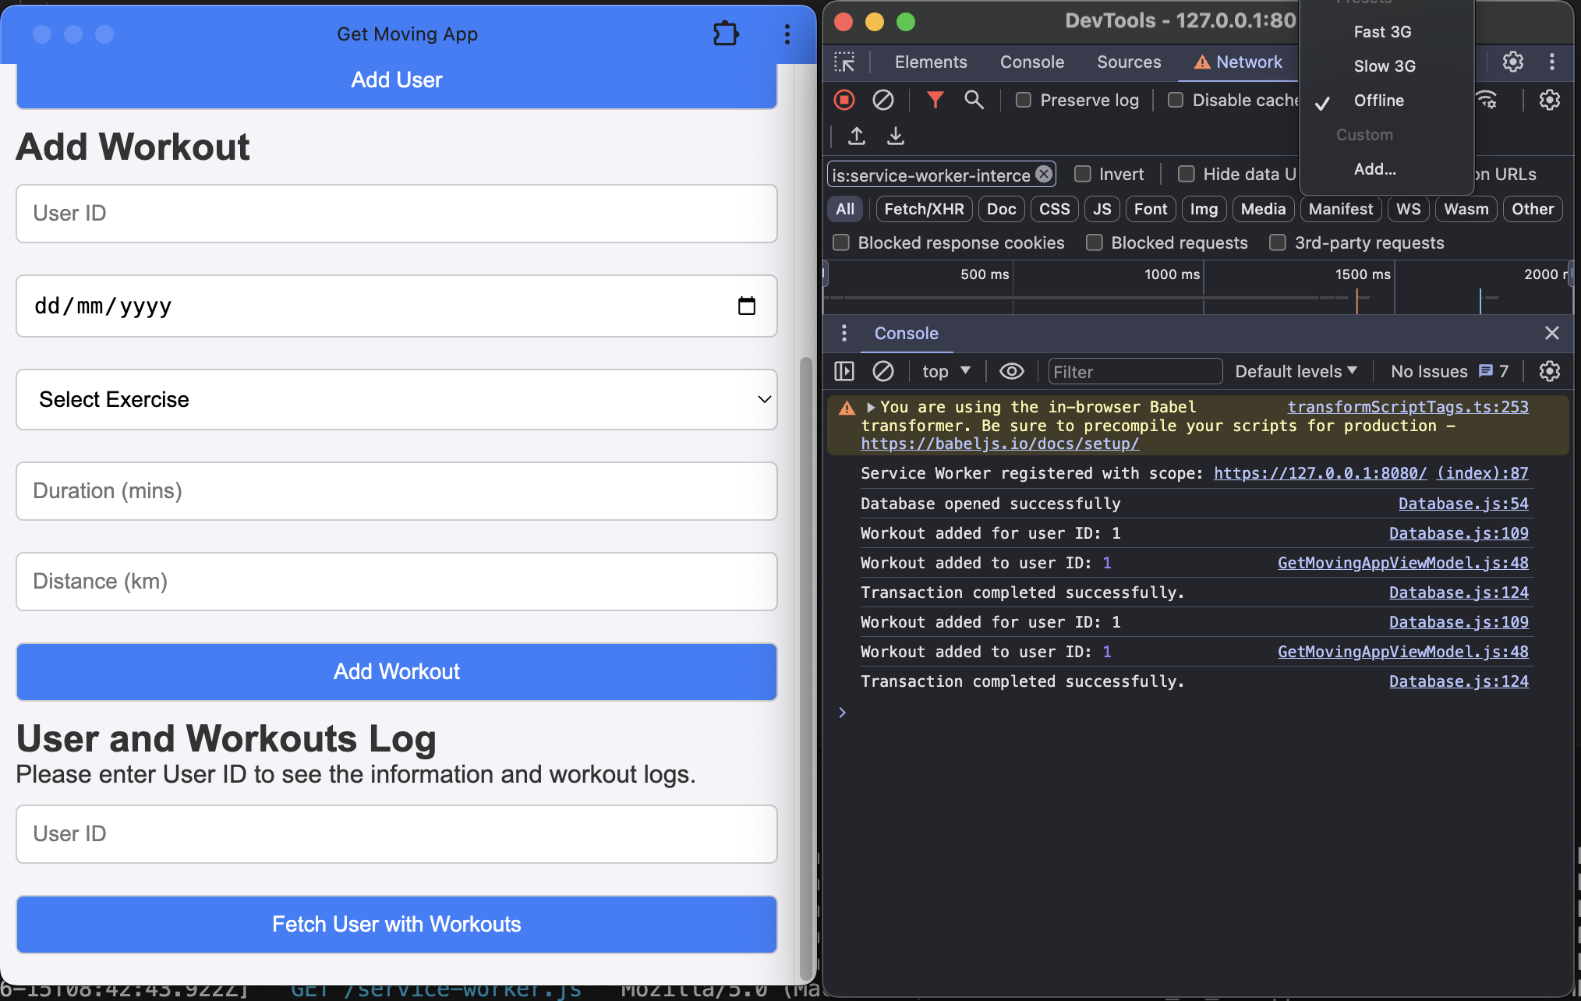
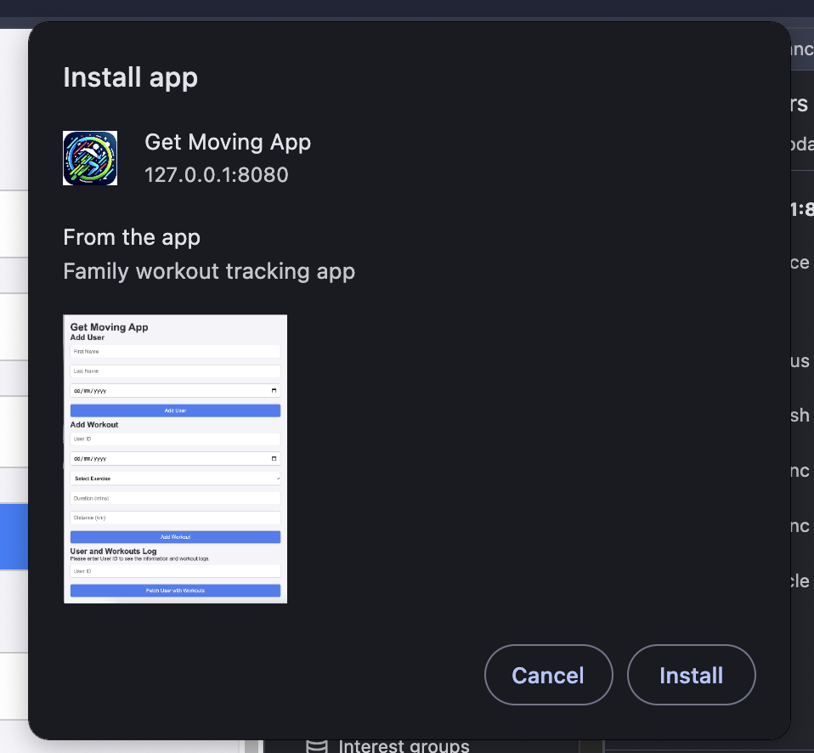
install App App Work while offline, Display a badge on the app icon and access data while offline

